Slide 1
Galaxy Transformations
Romeel Davé, U. Arizona/U. Western Cape

Slide 2
Outline
Jan 3: Physical processes that govern galaxy growth
How do galaxies get their gas?
What do they do with that gas?
How do these physical processes change with mass and time?
Where does stochasticity in these processes play a role?
Jan 4: Relating these physical processes to observations
Can we directly measure baryon cycling parameters?
How do inflows & outflows establish galaxy properties?
How are galaxies and surrounding gas connected?
Jan 8: Galaxy transformations
What are the major phases in a galaxy’s life?
What turns galaxies on? How is this observed?
What turns galaxies off? How is this observed?

Slide 3
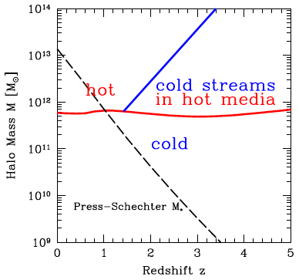
Phases of Galaxy Evolution
Birth Phase: Galaxies affected by photoionization.
M_{halo}<∼10⁹ M
Growth Phase: Star formation fueled by cold accretion, modulated by strong & ubiquitous outflows.
M_{halo}<∼10¹²⁺ M
Death Phase: Accretion quenched by AGN(?), growth continues via dry mergers.
M_{halo}>∼10¹² M
Phases distinguished by mass & governing feedback.
Growth phase dominates cosmic SF.
Death
Growth
Dekel+09
⬇Birth⬇

Slide 4
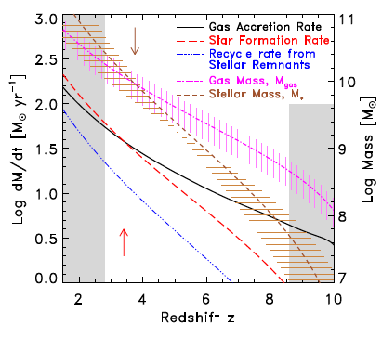
Gas Accumulation Phase: Observed(?)
For LBGs, compute:
M*, SFR from SED
M_{gas} from Σ_{SFR}, r
Best-fit SFR∼t^{1.7}.
… from z≈8-3.
Answer: Global gas accretion exceeds SFR at z>∼5.
Papovich+11

Slide 5
Reionization: Observations tell us…
- Reionization began at z>~10 (0.5 Gyr)
- Reionization ended at z~6 (1 Gyr)
- There are plenty of galaxies (and very few quasars) seen at z>~6.
Do galaxies alone emit enough photons to reionize?

Slide 6
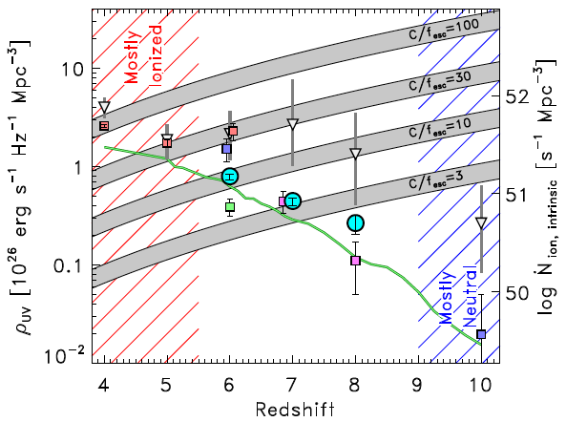
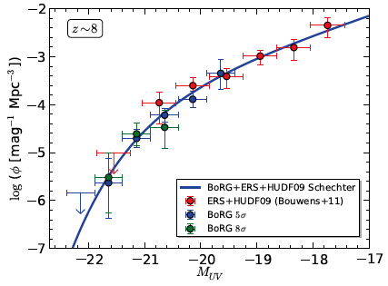
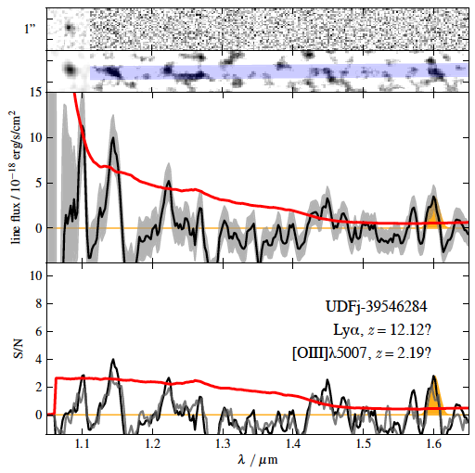
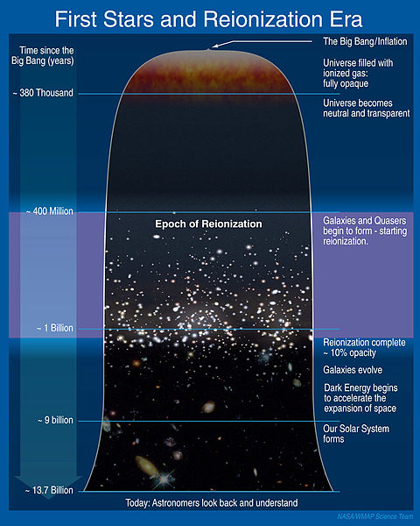
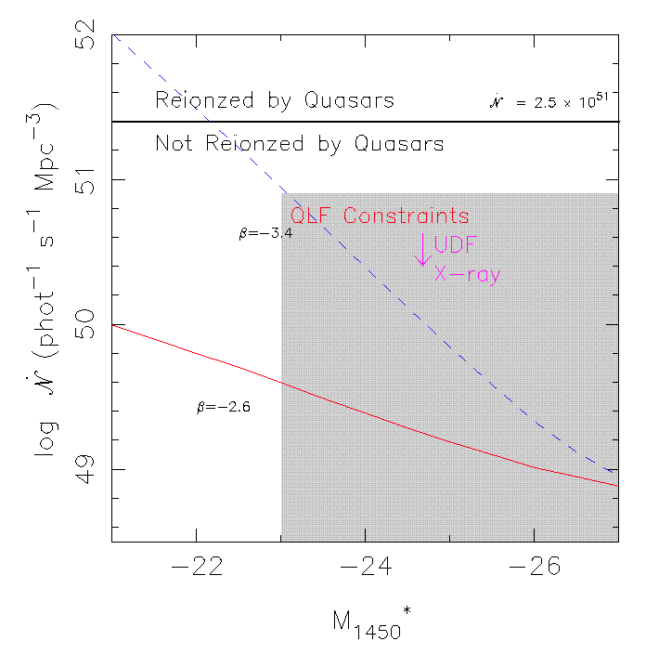
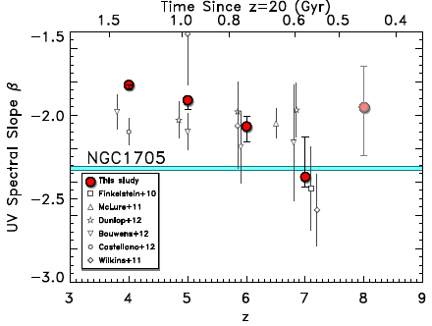
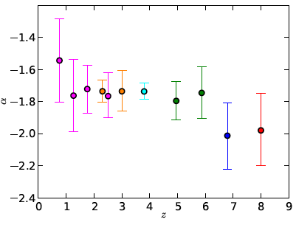
Sources
Galaxies likely dominate
Faint-end slope is key
UVLF at z<8 constrained
Identification at z>8 uncertain
Beta’s low but dust not obviously different
Currently don’t detect enough to reionize, but extrapolations of LF do.
Brammer+13
Fan+03
Bradley+12 (BORG)
Finkelstein+12

Slide 7
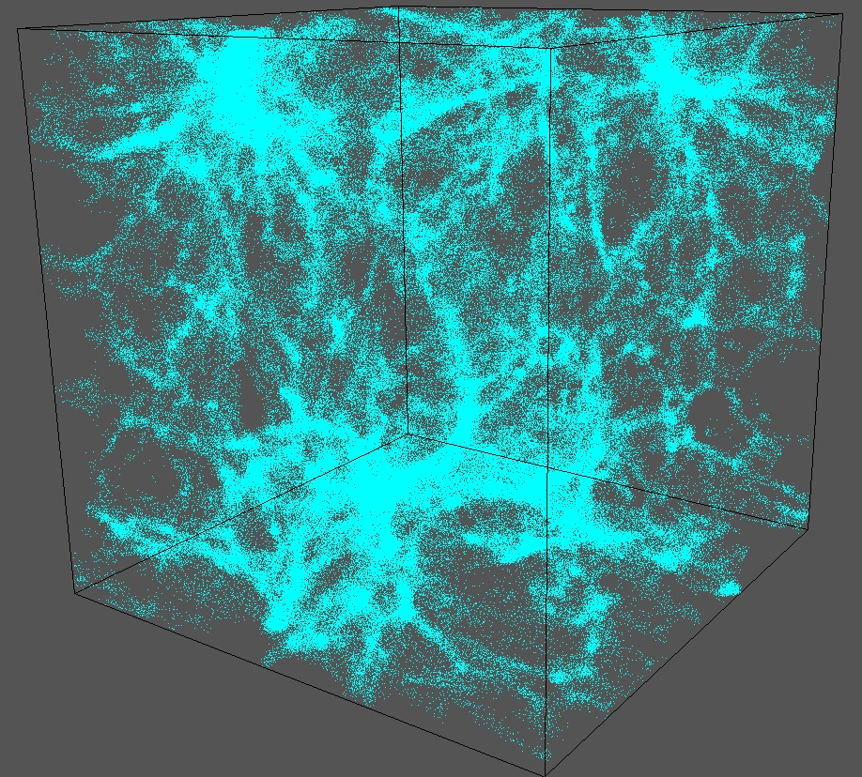
Reionizing Photon Budget
Q_{I} = Volume-averaged filling factor of ionized gas
n_{ph} = # of ionizing photons per unit volume
t_{rec} = recombination time, <~Hubble time at z>~6
Clumping factor C_{HII} = <n_{HII} n_{e}>/<n_{HII}><n_{e}>
Can (in principle) measure dn_{ph}/dt.
But to solve reionization, need C_{HII}, i.e.
topology.
z=9, 1 Mpc/h, dark matter

Slide 8
Topology of Reionization
Outside-in: Voids reionize first, then dense regions
Inside-out: Regions around galaxies ionize first, then voids
Competition between:
- Sources forming in overdense regions
- Galaxies are highly clustered at early epochs
vs.
- High recombination rates in dense regions
- Dense regions more self-shielded (shadowing)
Analytic results highly assumption-dependent.
Simulate!

Slide 9
Simulating Reionization: Physics
(1) structure formation with gas (density, temperature evolution)
(2) sources of photons (normal stars, Pop III stars, AGN, exotica)
(3) non-equilibrium thermal state
(4) non-equilibrium ionization state
(5) radiation transport

Slide 10
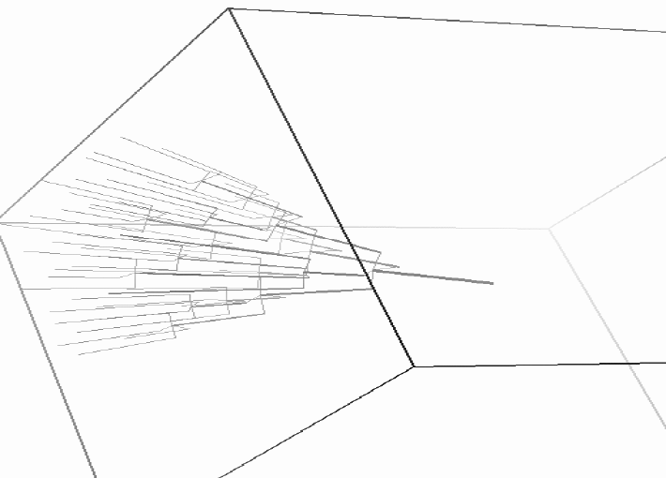
Monte Carlo & Ray tracing
Monte Carlo: Each source ejects N photons in random directions, track τ through cells until absorbed.
Ray tracing: Each source ejects N rays, attenuated until ∼zero.
Advantages: Simple; can split rays to save time.
Disadvantages: Scales with N_{sources}, N_{trials} needs to be large (expensive).
Gnedin & Abel 01

Slide 11
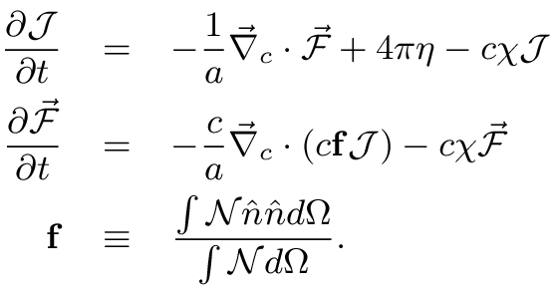
Moment-based methods: Solve on grid
Energy
eqn.
Flux
eqn.
Pressure/
“Eddington”
tensor
χ = Opacities
η = Emissivities
See Finlator, Ozel, RD 2009; Gnedin & Ostriker 1997
Options to calculate Eddington tensor f_{Edd}
- Assume optically thin (OTVET) or M1 closure (RamsesRT)
- Derive from accurate ray tracing (MARCH). Expensive, but since structure evolves slowly, can do it less often.

Slide 12
RT Codes in Cosmology
Code method c=? shadows scaling comments
C2-ray ray-tracing ∞ yes N*N_{x}³ n-body
ART ray-tracing ∞ ? N*N_{x}³
FLASH-HC ray-tracing ∞ yes N*N_{x}³
TRAPHIC ray-tracing c yes N_{c}N_{SPH} mass resolution limit?
CRASH monte carlo ∞ yes N*N_{γ} time dependence?
OTVET* moments << c ? N_{x}³ optically-thin f_{Edd}
MARCH* moments c yes N_{x}^{~4}
Zel'dovich approximation +irradiated boundary
accurate f_{Edd}; coupled to Gadget
* Have been implemented into a cosmological radiation-hydro code

Slide 13
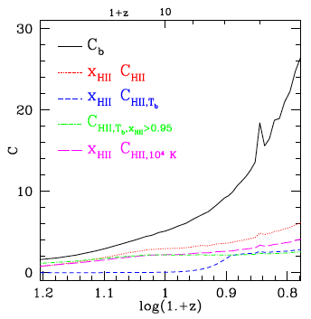
Clumping Factor Versus Redshift
Clumping factor is much lower than early analytic models had assumed.
C_{HII} evolves slowly. Low C makes reionization a lot easier.
Can likely reionize with galaxies!
Finlator+12
C=30: Gnedin & Ostriker (1997)
Pawlik & Schaye (2008);
Bolton &
Haehnelt
(2008)
Finkelstein+12

Slide 14
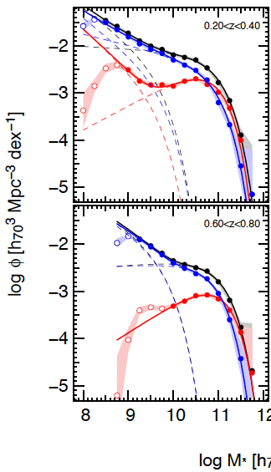
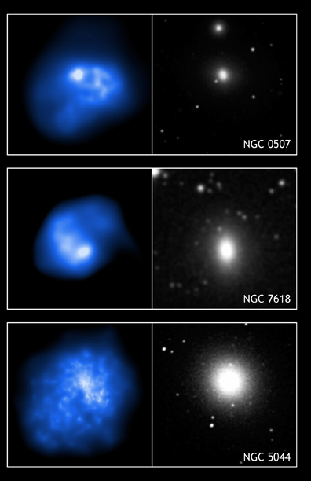
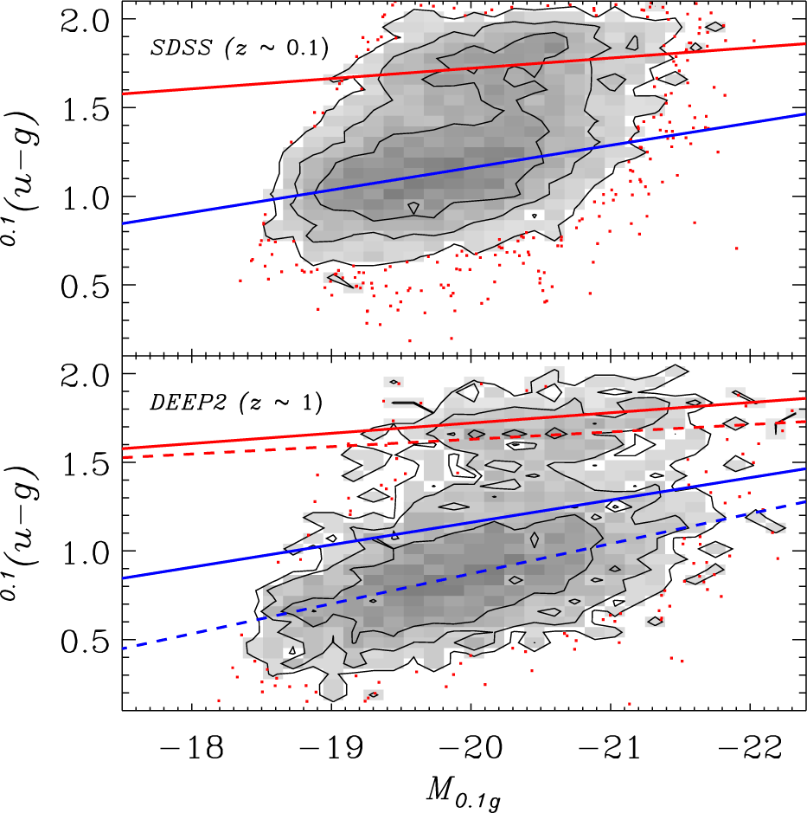
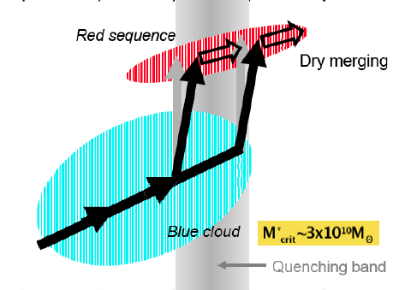
Galaxy Death
Faber+07
Red sequence: No SF 1+ Gyr
Mass function: Exp cutoff
Morphology: Elliptical
X-ray gas is disturbed
Timescale: [Mg/Fe](σ)
Black holes: M_{BH}-σ_{bulge}
Blanton+2006
Drory+09

Slide 15
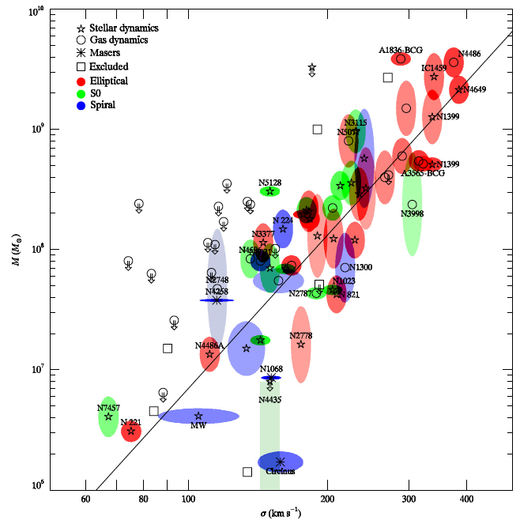
M-σ relation
M_{BH}≈0.001-0.002M_{bulge}.
Schwarzschild radius: R_{s}=2GM/c²≈10⁻⁶ pc M₉
Sphere of influence:
R_{h}=2GM/σ²≈100 pc M₉
Bulge R_{e}∼4 kpc M₉^{1/3}
Gultekin+09

Slide 16
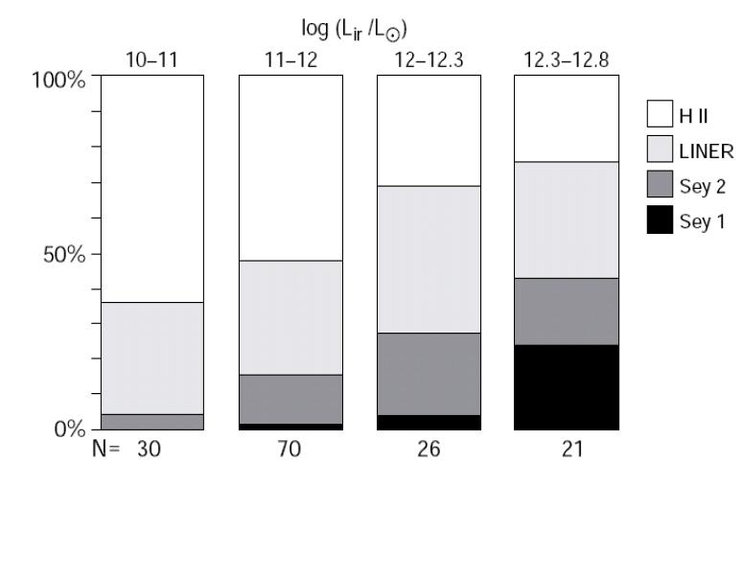
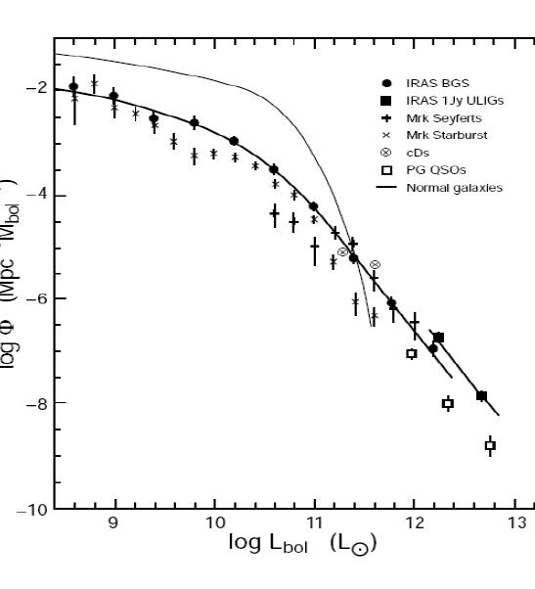
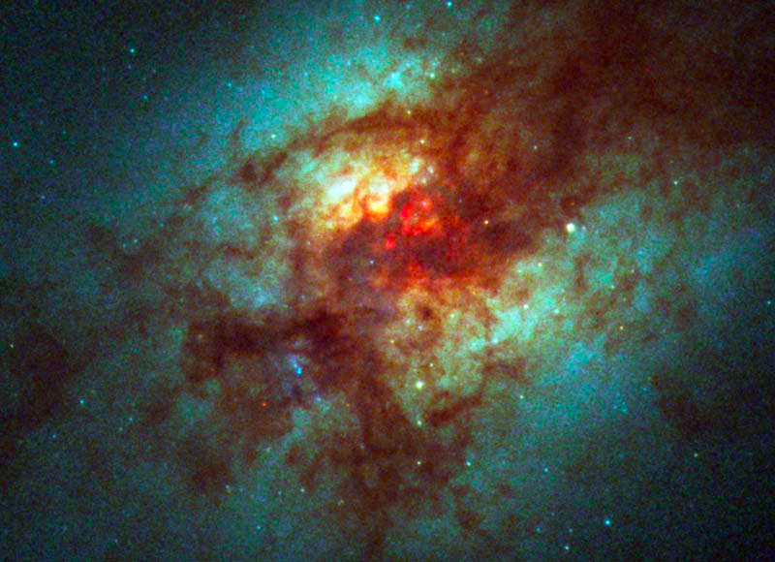
Merger-Starburst-AGN Connection
Mergers grow bulge.
Mergers grow BH: AGN more common in ULIRGs.
Arp 220
from V. Wild
Sanders & Mirabel 96

Slide 17
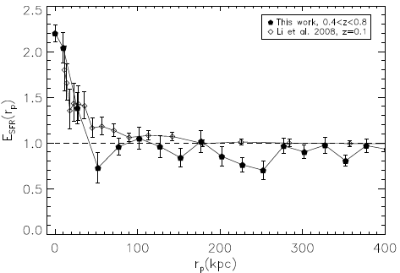
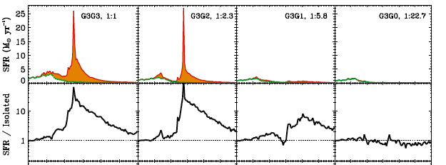
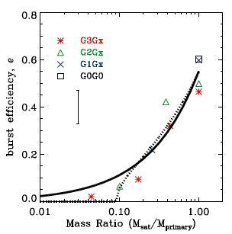
Mergers are not always starbursts
e = f_{*,burst}-f_{*,iso}
Maximum for coplanar, low-f_{gas} mergers.
Robaina+09
Cox+08
Observed: Total SFR enhance-ment in pairs ≈8±3%.
Cox+08

Slide 18
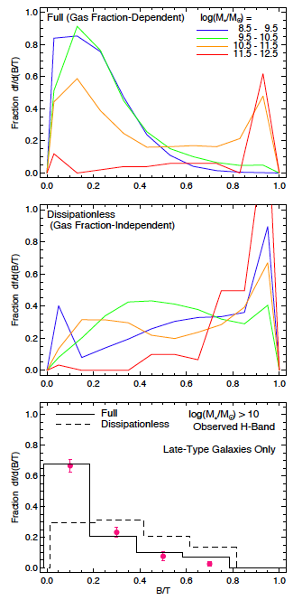
Morphological Transformation
Mergers make earlier-types, but…
Bulge growth depends on f_{gas}.
Hopkins+09

Slide 19
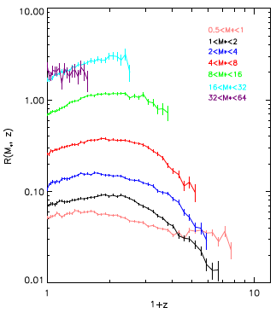
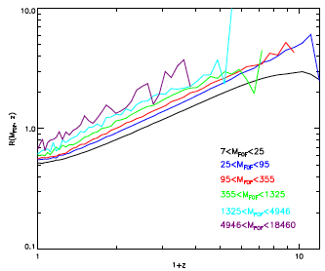
Mergers Across Cosmic Time
Galaxies
in 10¹⁰ M_{o}
Galaxy growth rate via mergers strong fcn of mass.
Halo growth rate via mergers strong fcn of z.
Mergers become dominant at M*>∼ 10¹¹ M.
At lower masses, mergers can happen but accretion continues.
Halos
Guo & White 08

Slide 20
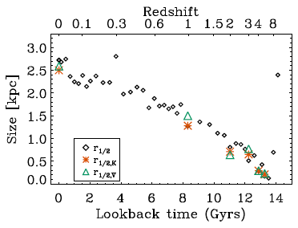
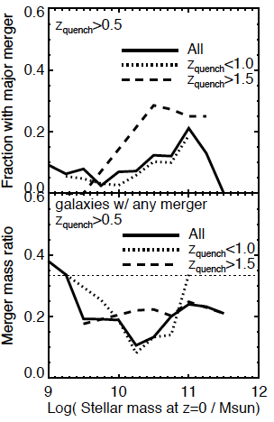
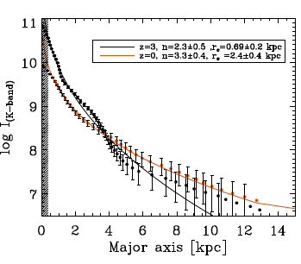
Dry merging in massive galaxies
E’s show low-SB tidal features
Size evolution:
Major merger growth rate not large
Minor mergers can explain size evol
Gabor&RD 12
Naab+09

Slide 21
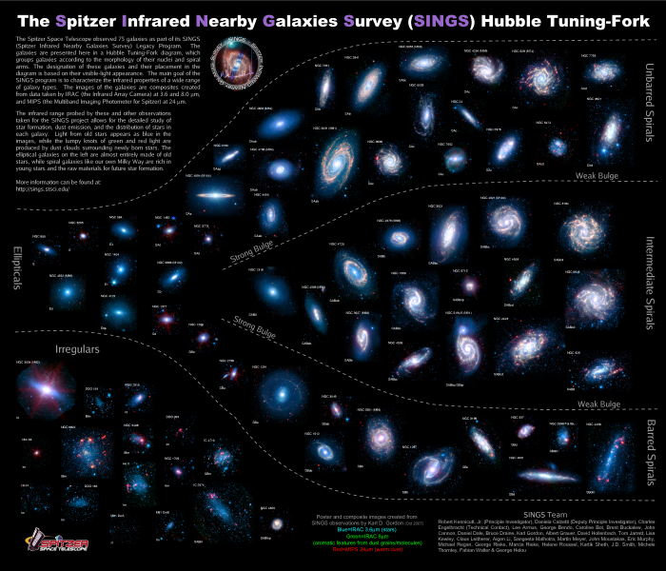
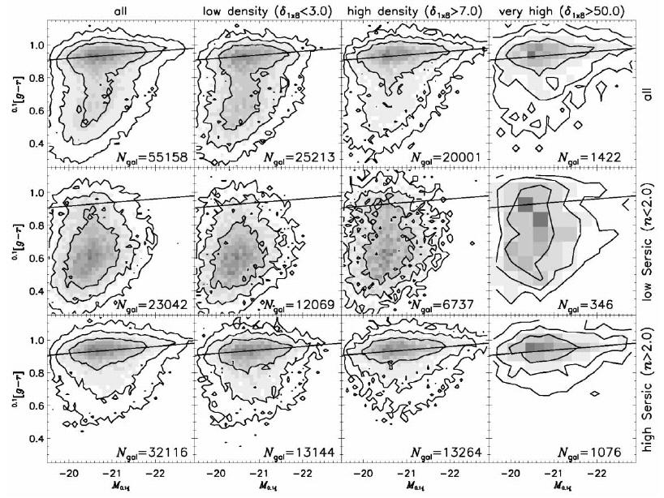
Quenching Star Formation

Slide 22
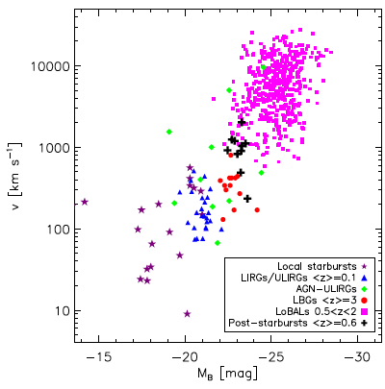
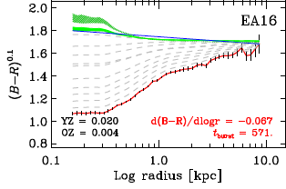
Caught in the Act of Quenching: Post-Starbursts
Strong Balmer lines (SF in last <1 Gyr), but weak [OII] (no ongoing SF).
Generally show blue cores, disturbed
Recent strong outflows
Tremonti+07
Yang+08
Tremonti+09

Slide 23
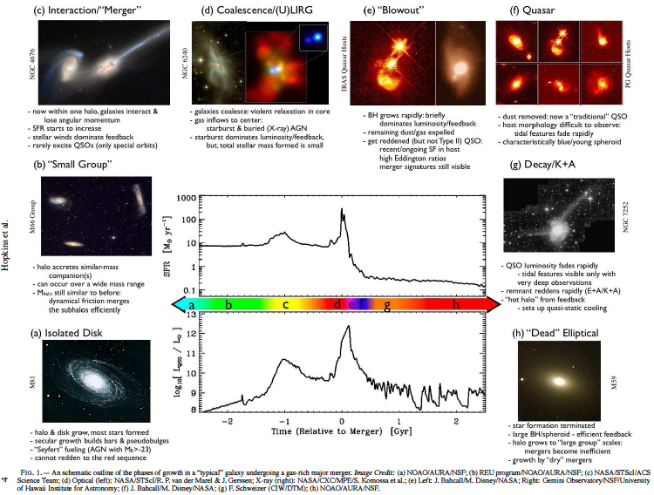
How Does AGN Feedback Work?
Hopkins+08

Slide 24
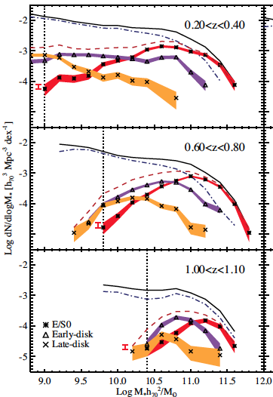
But… red & dead disks!
Morphology & color trans-formation not always coeval.
Could represent as much as 60% of early-type mass today.
Suggests that other phenomena besides major mergers quench
Bundy+10

Slide 25
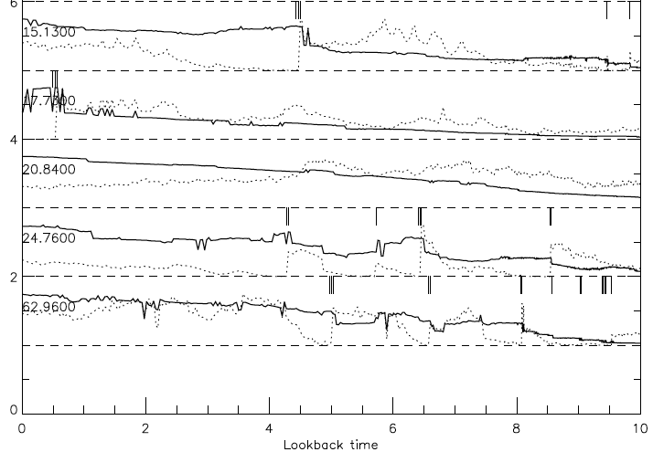
Also need to keep gas out
Even if gas completely ejected after merger, SF restarts in 1-2 Gyr.
Need a maintenance mode.
Gabor+09
Merger ejects all SF’ing gas
⬆ mass (solid)
SFR (dotted)
⬅ time

Slide 26
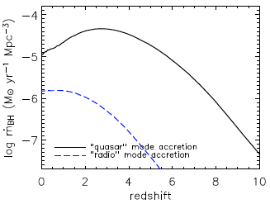
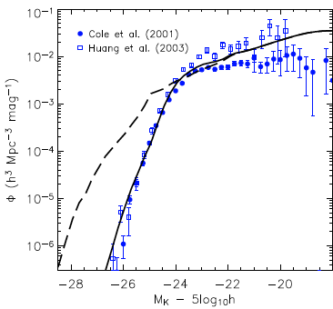
“Radio Mode” Feedback
•
M_{BH}/M_{BH} ∼ M_{halo}
Tuned to become important above L*.
BH grows via “quasar mode”, but then radio mode kicks in.
Croton+06

Slide 27
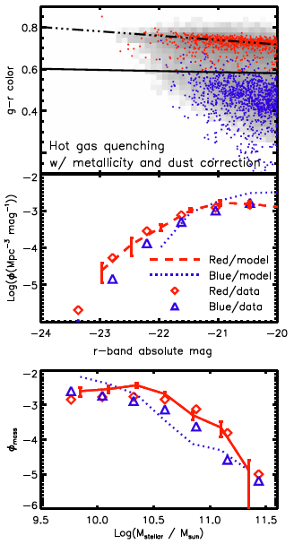
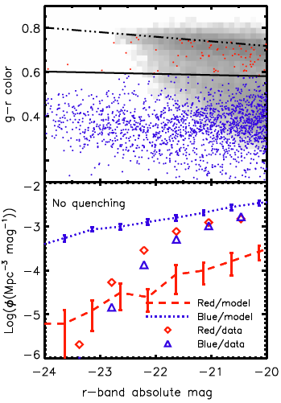
Radio mode alone yields red & deads
Gabor, RD+11
Heat halo gas when f_{hot}>0.6
Produces correct:
Red sequence
Bright-end luminosity/mass fcn
Does not change faint end
Quenching physics uncertain, but it likely has to do with hot halo gas!
Adding quasar mode doesn’t help or hurt.

Slide 28
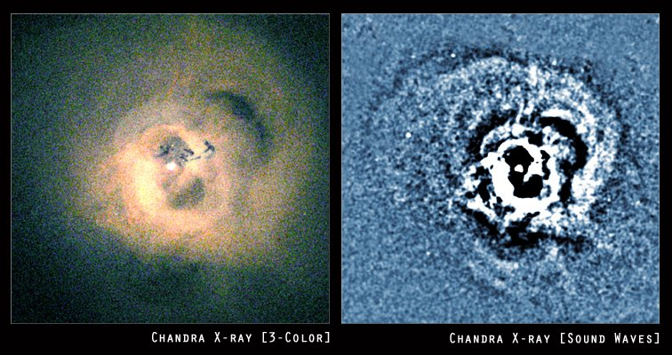
Feedback from Radio Jets: Clusters

Slide 29
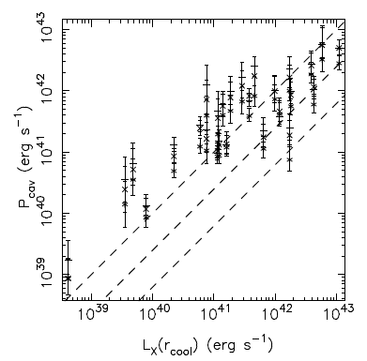
Heating Balances Cooling
Measure PdV heating in bubbles, compare to X-ray emission.
How to “sphericalize”? Sound waves?
Nulsen+07

Slide 30
Types of AGN Feedback
Quasar mode: Ejection of cold gas by merger/QSO.
+ Explains QSO-merger-starburst connection
+ Grows BH in accord with M-σ relation
+ Mergers more important in higher-mass galaxies.
- Can’t keep gas out – IGM will eventually provide fuel
- Requires ∼spherical energy injection
Radio mode: Pumping of hot halo by radio jets.
+ BH provides energy (intermittently) even when no SF
+ Works only when hot halo is present, i.e. higher mass.
+ Adds entropy to intracluster gas
- Accretion is slow: Can’t grow BH much
- Unclear how to “sphericize” jet energy
- Can’t provide rapid shutoff seen in post-starbursts
Hybrid: QSO grows BH and initially quenches, radio mode maintains galaxy

Slide 31
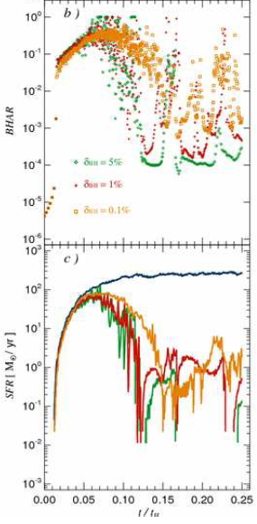
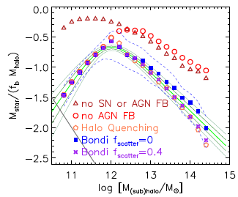
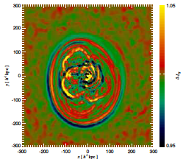
Hybrid AGN Feedback: Sims & SAMs
Sims: Track BH growth (Eddington-limited Bondi), add feedback as fixed fraction of dM_{BH}/dt (~0.5%).
SAMs: Quasar mode in mergers grows BH, radio mode in massive halos maintains red & dead ETGs. Works!
Sijacki+07

Slide 32
Summary: Transformations
Birth phase of galaxies now being probed.
Galaxy LF to z∼8: photon budget almost enough w/low C
C_{HII}∼3-5 comes from rad-hydro sims
Black hole and bulge growth are connected; mergers a key element for both. Makes galaxies:
Elliptical
Red (gas-poor)
Have BH’s on M-σ relation
AGN feedback also seen in massive halos (clusters)
Keeps galaxies dead (& red)
Adds entropy to hot gas
Both seem to be needed to grow BH’s then quench ETGs.

Slide 33
Evolution of galaxy formation theory from 15 years ago until today
Stellar and metal growth limited by cooling rate and conversion of gas into stars
balance between accretion and feedback
Gas content reflects “evolutionary state”
gas supply vs. consumption rate
Mergers fuel galaxy growth & evolution
are subdominant to cold streams for fueling
Galaxies’ life phases driven by halo assembly
set by different feedback mechanisms: J_{ν}, winds, BH
Galaxies & IGM evolve independently
are connected by baryon cycling

